Slide 1
ETL
Natural Disasters
Orlando Leckie, William Abate, Verenice Vargas

Slide 2

What are natural disasters?
Natural disasters are extreme, sudden events caused by environmental factors.
Examples:
Earthquakes
Tsunamis
Hurricanes/Tropical Storms
Wildfires
Tornadoes
Sources:https://www.planetaryhealthalliance.org/natural-disasters ; https://www.samhsa.gov/find-help/disaster-distress-helpline/disaster-types ;
(Photo) https://www.kindpng.com/picc/m/44-442679_clip-art-wild-fires-trees-on-fire-clipart.png

Slide 3
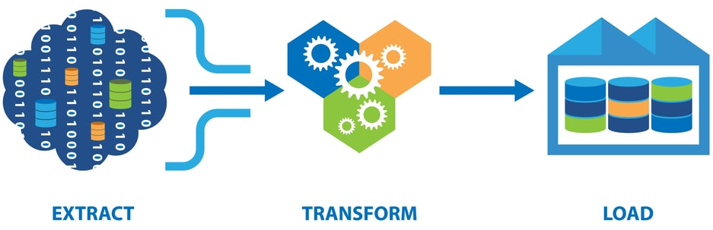
ETL
Sources: (Photo) https://qatesttraining.com/wp-content/uploads/2021/11/five-steps-of-etl-process.jpeg ; https://wikitable2csv.ggor.de/

Slide 4
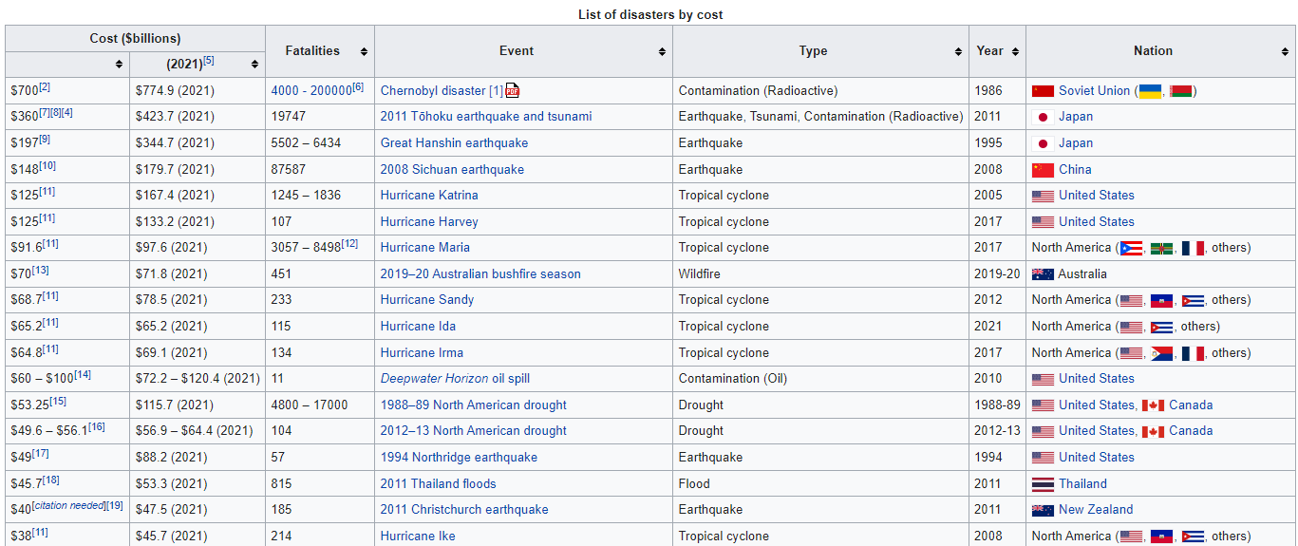
Extracting
Sources: https://en.wikipedia.org/wiki/List_of_disasters_by_cost

Slide 5
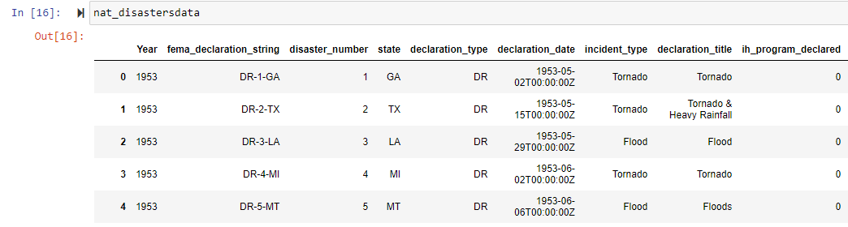
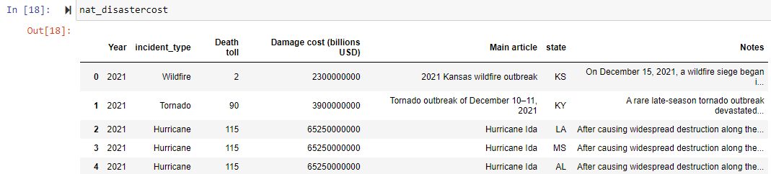
Extracting
Sources: https://en.wikipedia.org/wiki/List_of_disasters_by_cost

Slide 6
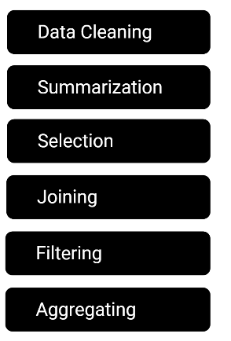

Transforming
In order to transform the data, we performed the following:
Used Pandas functions in Jupyter Notebook to load two CSV files
Reviewed the files and transformed into data frames
Dropped rows where the year was before 2000
Focused on natural disasters in California and Texas only
Reset the index
Sources: (Photo) http://clipart-library.com/free/gear-clipart-transparent.html

Slide 7
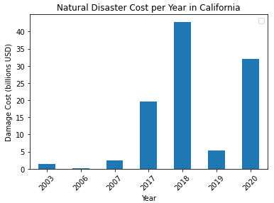
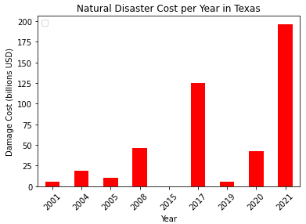
Natural Disaster Cost per Year
Astype float
Groupby year + sum
Matplotlib for bar graphs

Slide 8
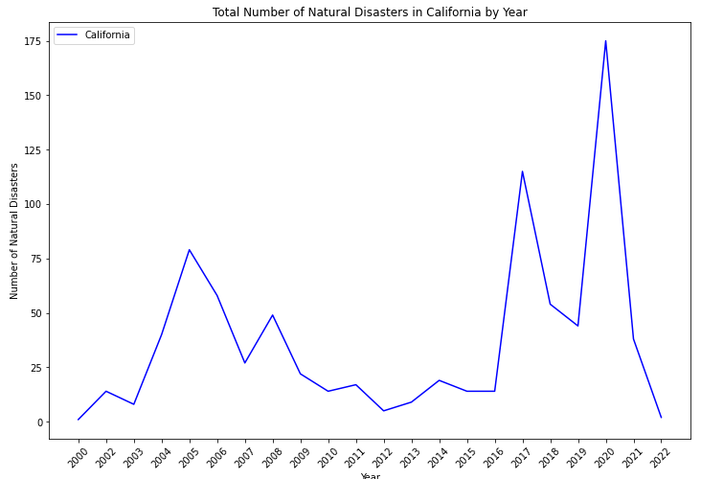
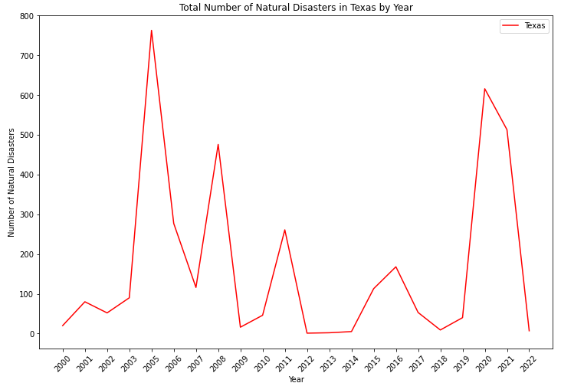
Total Number of Natural Disasters
Astype string
Groupby year
Matplotlib for line graphs

Slide 9
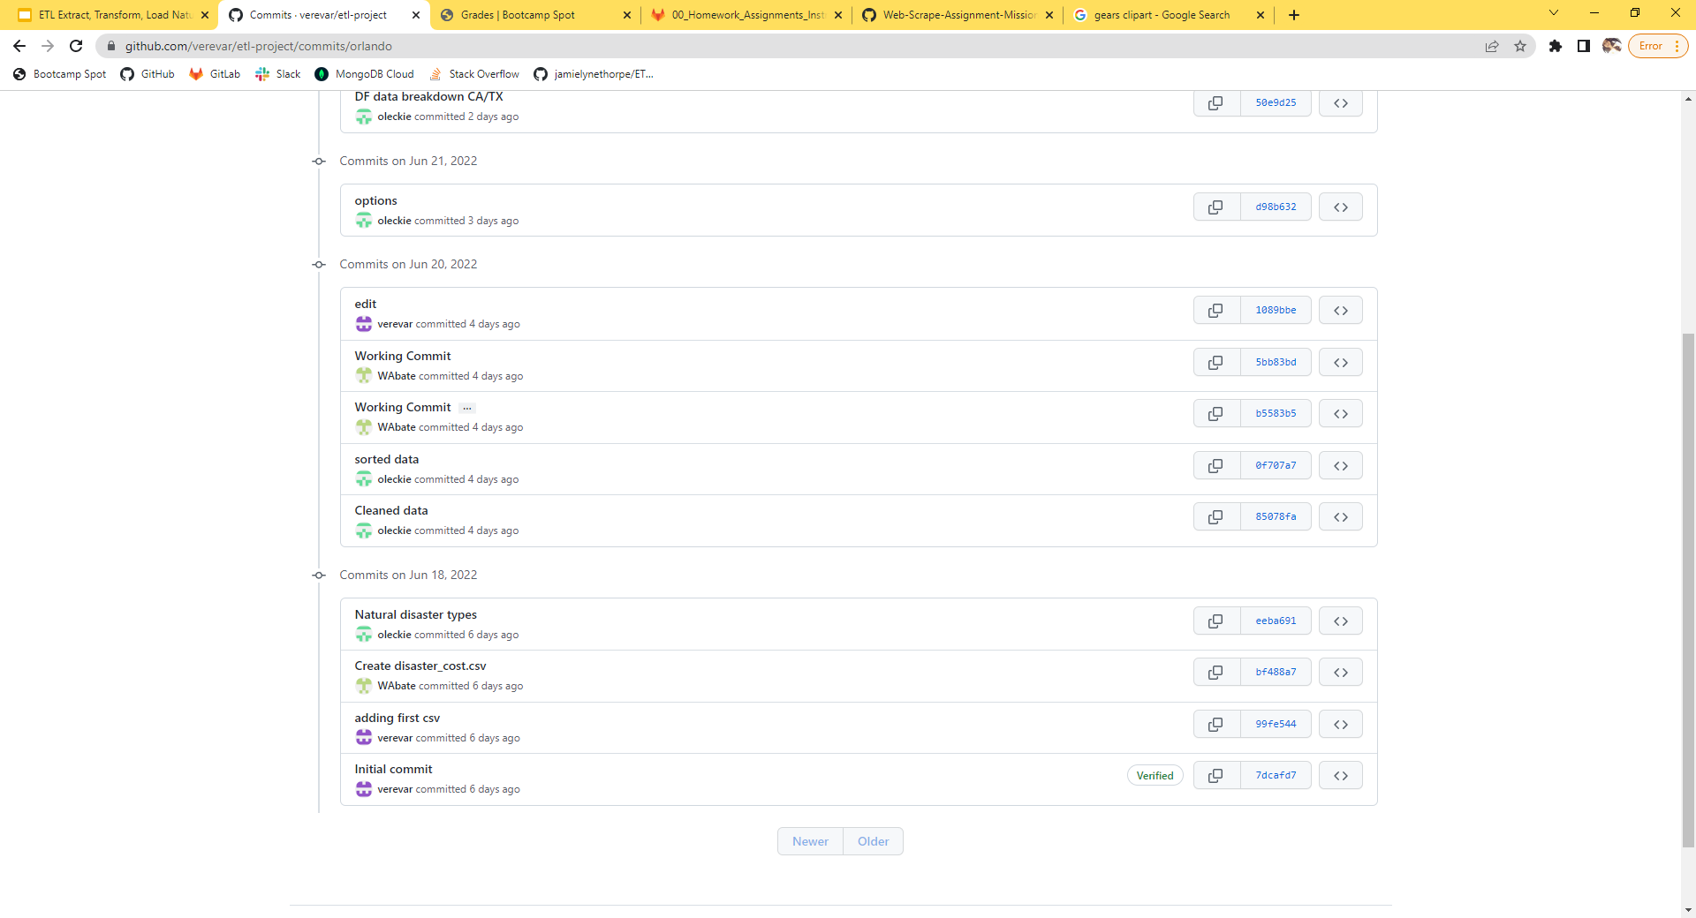

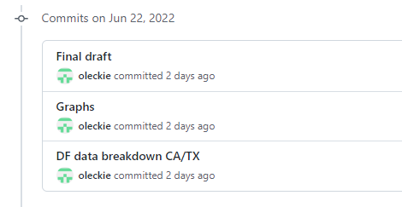
Loading Process
Sources: (Photo) https://cdn-icons-png.flaticon.com/512/25/25231.png

Slide 10
Summary

